Slide 1
Protecting your Content
Demystifying Data Loss Prevention (DLP) in SharePoint 2016
Presented to:
Cincinnati SharePoint User’s Group
April 26, 2018

Slide 2
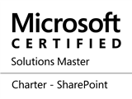
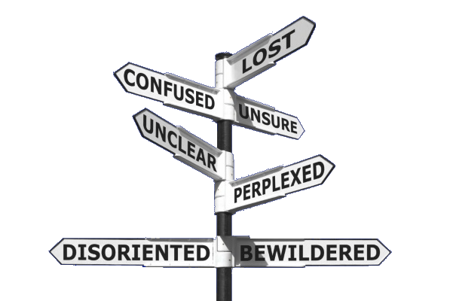
Paul Papanek Stork
Owner/Principal Architect
Don’t Pa..Panic Consulting
Author
Developer’s Guide to WSS 3.0
MOSS 2007 Best Practices
MCTS: WSS 3.0 Configuration Study Guide (70-631)
SharePoint 2010 Development for Office 365
Microsoft Community Contributor
Technet Forums
MSDN Forums
Yammer Groups
Contact Information
Email: pstork@att.net
Blog: http://dontPaPanic.com/blog
Twitter: @PStork
Notes:
Principal SharePoint Architect for BlueChip Consulting Group
http://www.bluechip-llc.com
SharePoint MVP for 9 years
SharePoint Microsoft Certified Master
Author
Developer’s Guide to WSS 3.0
MOSS 2007 Best Practices
MCTS: WSS 3.0 Configuration Study Guide (70-631)
SharePoint 2010 Development for Office 365
Contact Information
Email: Paul.Stork@bluechip-llc.com
Blog: http://dontPaPanic.com/blog
Twitter: @PStork

Slide 3
Agenda
What is Data Loss Prevention (DLP)?
Compliance Center and eDiscovery Center
How Does it Work?
DLP Queries & Policies
DLP Templates
Actions
Can I create custom DLP Templates, Queries, and Policies?
Office 365 vs. SharePoint 2016

Slide 4
What is Data Loss prevention?
Data Loss Prevention (DLP) - a strategy for controlling dissemination of sensitive information
Data Loss Prevention Types
In Use
Office Client Applications
In Motion
Exchange
At Rest
SharePoint On-Premises

Slide 5
Foundation Concepts
DLP in Exchange since 2013
Added to SharePoint 2016 & SharePoint Online
Personally identifiable information (PII) = Sensitive Information Types
Not a replacement for Records Management
Won’t guarantee retention
Identified during Search Crawl processing

Slide 6
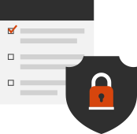
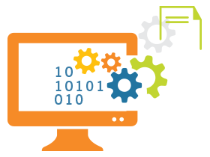
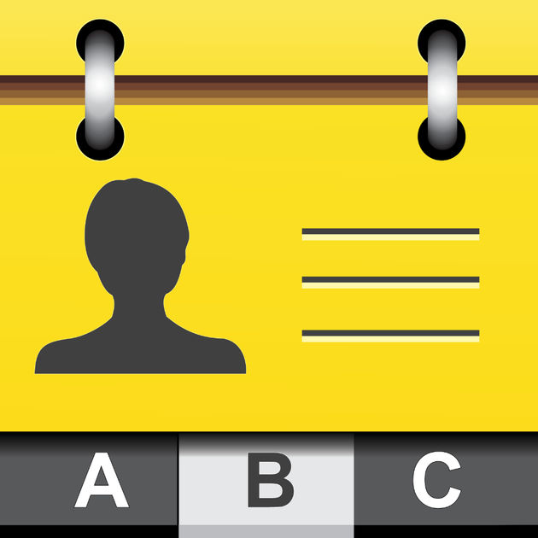
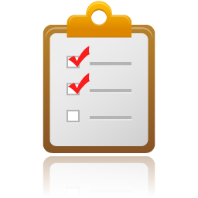
Processing in SharePoint 2016
Sensitive Information Types
Content
Sources
Crawler
Query
Content Processing
Index
User
Policy Definitions
Unified Policy Processing Tasks
Notes:
Typically Search works like this
Backend
You have searchable content
It is crawled – goes in the content and capture all the information (This is when Sensitive Information Types are added)
Content processing will analyze and apply exclusion and pass to index
Front End
A user makes a query
The query searches the index for the information and responds back to the user
DLP creates uses the Policy Definition
Looks for Sensitive information in the index.
You need to have the information in the index before you can apply policies to it
*** If you don’t search a site collection you can’t ’’ apply policies to it.
If you are doing daily crawls, you could have a gap of 24 hours before it is indexed.

Slide 7
Sensitive information types
Sensitive Information types contain
A formatted or unformatted pattern (regex)
Proximity to a keyword (like SSN or Social Security Number)
Sensitive Information Type Examples
Personal Identifiable Information (PII)
Credit Card Numbers
Social Security Numbers
Bank Account Numbers
Passport Numbers
Driver’s License Numbers
https://technet.microsoft.com/en-us/library/jj150541(v=exchg.160).aspx

Slide 8
DLP queries & Policies
Compliance Center & eDiscovery Center
Notes:
&

Slide 9
DLP Queries
DLP Queries
Used for Testing potential Policies
Find content that contains sensitive information
Understand your risks & security exposure
Determine the location of content that your DLP policies need to protect
Where to create them?
Office 365 - Security and Compliance Center
SharePoint 2016 - eDiscovery Center

Slide 10
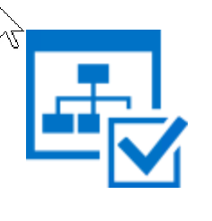
DLP Policies
DLP Policies
Contain a Policy Template
Rule definition based on the Policy Template
Actions taken in Response to the Rule
Where to create them?
Office 365 - Security and Compliance Center
SharePoint 2016 - Compliance Center
Notes:
DLP Policies: Use the Compliance Policy Center site collection to notify end users and administrators when documents with sensitive information are stored in SharePoint and automatically protect the documents from improper sharing. You can also create basic policies that allow you to delete content in OneDrive for Business much like you can with standard retention policies. The policies allow you to ensure that your SharePoint investment is providing the security and compliance posture that modern organizations require for their digital systems.

Slide 11
Other Policies
Deletion Policies
Delete documents after a specified period of time
Similar to Retention Policies in Document Libraries
Assigned the same way as DLP Policies
OneDrive is the primary Use Case
https://blogs.msdn.microsoft.com/mvpawardprogram/2016/01/13/data-loss-prevention-dlp-in-sharepoint-2016-and-sharepoint-online/

Slide 12
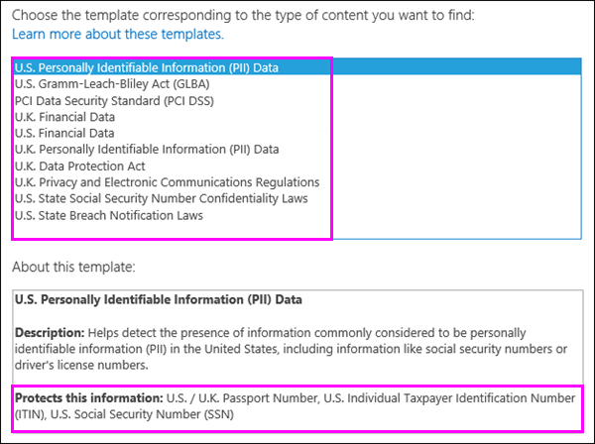
DLP Policy Templates
Identifies specific types of sensitive information
May combine different sensitive information types
Correspond to common regulatory requirements
Implement regional differences
Notes:
When you create a DLP query or a DLP policy, you can choose from a list of DLP templates that correspond to common regulatory requirements. Each DLP template identifies specific types of sensitive information – for example, the template named U.S. Personally Identifiable Information (PII) Data identifies content that contains U.S. and U.K. passport numbers, U.S. Individual Taxpayer Identification Numbers (ITIN), or U.S. Social Security Numbers (SSN).

Slide 13
Creating a DLP query
Based on a DLP Policy Template or Custom
Numerical Threshold of Sensitive Information items
Confidence level – (Office 365 only)
Refine Query using
Date Range
Author/Sender
Query Scope limited by location
Filter based on SharePoint metadata
like Author, Content Class or Content Type
Context – Shared Internally or Externally (Office 365 only)

Slide 14
Creating a DLP Query

Slide 15
Creating a DLP Policy
Based on a DLP Policy Template
Conditions that the content must match before the rule is enforced
Numerical Threshold of Sensitive Information items
Context – Shared Internally or Externally (Office 365 only)
Actions that you want the rule to take
Send an Incident report by email
Display a Policy tip to the user
Block access to the document

Slide 16
Policy Tips
Policy Tip - A notification or warning that appears when someone is working with content that conflicts with a DLP policy
Used to Increase awareness
Can be used to override DLP policy blocking
Valid Business reason
False Positive

Slide 17
Applying a DLP Policy
Assigned to a Site Collection
By URL
By Title
Assigned to a Site Template
A specific Site Template
OneDrive for Business Template (applies to all OneDrive sites)
Other Settings
Default Policy
Mandatory Policy (only one policy allowed)
Notes:
5 timer jobs involved
Compliance Dar Task House Keeping Compliance High Priority Policy Processing Compliance Dar Processing Compliance Policy Processing Unified Policy OnPrem Sync Job

Slide 18
Creating a DLP Policy

Slide 19
User Experience
SharePoint Web & Office Clients
Notes:
&

Slide 20
User Experience
Icons
Sensitive Information
Blocked
Office Client Applications
Policies synced to local Clients
Only Works for Domain joined machines

Slide 21
Administering DLP
SharePoint 2016 & Office 365
Notes:
&

Slide 22
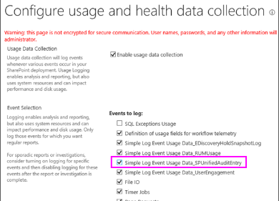
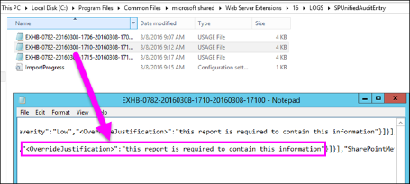
Administering DLP
View DLP policy activity in the usage logs
Example - view the text entered by users when they override a policy tip or report a false positive.
Enable the option in Central Administration
Monitoring > Configure usage and health data collection > Simple Log Event Usage Data_SPUnifiedAuditEntry).

Slide 23
Office 365 vs. SharePoint 2016
Office 365
Sharepoint 2016
Security & Compliance Center
Activity Alerts
Compliance Roles
DLP Policies
Deletion Policies
Audit Log search
Sensitive Information Queries
Compliance Center
DLP Policies
Deletion Policies
eDiscovery Center
Sensitive Information Queries
Individual Sites
Audit Log search

Slide 24
Hybrid Audit Logging
Search file access activities
Office 365
On-premises SharePoint 2016
Configure
Office 365 - Turn On Audit Log Search Recording in Compliance & Security Center
On-Premises – Configure Usage and Health Data Collection in Central Admin
Enable Hybrid Audit Logging in Hybrid Picker

Slide 25
Limitations
Dependence on Search Crawl leaves loopholes
Cannot Create Custom Rules on-Premises –YET!
1 Policy Center Per Web Application
Real-time scanning requires Domain joined machines
One-to-one Site Collections & Policy Mappings
Hybrid Does not Work That Well…
Systems actions – Blocking, flagging, etc. works by timer jobs
Office 365 cannot access On-Premises timer jobs

Slide 26
Office 365 security & Compliance Center

Slide 27
Custom Types
Office 365 only for now
Contents
Entity – Type of Information, ex. Employee ID
Rule – Regular Expression
Pattern – Supporting evidence
Different combinations represent confidence levels
https://support.office.com/en-us/article/Create-a-custom-sensitive-information-type-82c382a5-b6db-44fd-995d-b333b3c7fc30?ui=en-US&rs=en-US&ad=US

Slide 28
Custom Type Example
<?xml version="1.0" encoding="utf-16"?>
<RulePackage xmlns="http://schemas.microsoft.com/office/2011/mce">
<RulePack id="b4b4c60e-2ff7-47b2-a672-86e36cf608be">
<Version major="1" minor="0" build="0" revision="0"/>
<Publisher id="7ea13c35-0e58-472a-b864-5f2e717edec6"/>
<Details defaultLangCode="en-us">
<LocalizedDetails langcode="en-us">
<PublisherName>Don't Pa..Panic</PublisherName>
<Name>Sample Sensitive Info</Name>
<Description>A Sample DLP Sensitive Info Type</Description>
</LocalizedDetails>
</Details>
</RulePack>

Slide 29
Custom Type Example – Part 2
<Rules>
<!-- bad word match list -->
<Entity id="acc59528-ff01-433e-aeee-13ca8aaee159“ patternsProximity="300“ recommendedConfidence="75">
<Pattern confidenceLevel="75">
<IdMatch idRef="BadWordList" />
</Pattern>
</Entity>
<Keyword id="BadWordList">
<Group matchStyle="word">
<Term>Google</Term>
<Term>FOR INTERNAL USE ONLY</Term>
</Group>
</Keyword>

Slide 30
Custom Type Example – Part 3
<LocalizedStrings>
<Resource idRef="acc59528-ff01-433e-aeee-13ca8aaee159">
<Name default="true" langcode="en-us">
Sample Sensitive Info
</Name>
<Description default="true" langcode="en-us">
A Sample DLP Sensitive Info Type
</Description>
</Resource>
</LocalizedStrings>
</Rules>
</RulePackage>

Slide 31
Adding a Custom DLP
$UserCredential = Get-Credential
$Session = New-PSSession -ConfigurationName Microsoft.Exchange -ConnectionUri https://ps.compliance.protection.outlook.com/powershell-liveid/ -Credential $UserCredential -Authentication Basic -AllowRedirection
Import-PSSession $Session
New-DlpSensitiveInformationTypeRulePackage -FileData (Get-Content -Path “Path To XML\DLPfile.xml " -Encoding Byte)
Get-DlpSensitiveInformationType | where {$_.Name -like "Sample*"}
Remove-DlpSensitiveInformationTypeRulePackage -Identity "b4b4c60e-2ff7-47b2-a672-86e36cf608be"
Remove-PSSession $Session

Slide 32
Additional resources
DLP Sensitive Information Types https://technet.microsoft.com/en-us/library/jj150541(v=exchg.160).aspx
Create a custom sensitive information type https://support.office.com/en-us/article/Create-a-custom-sensitive-information-type-82c382a5-b6db-44fd-995d-b333b3c7fc30
Create a DLP policy in SharePoint Server 2016 https://support.office.com/en-us/article/Create-a-DLP-policy-in-SharePoint-Server-2016-0bd9c41e-8ed4-4cd5-b4e8-0c0f66d8d538?ui=en-US&rs=en-US&ad=US

Slide 33
Questions?

