Slide 1
Desired State Configuration (DSC)
Controlling SharePoint Deployment in Azure VMs

Slide 2



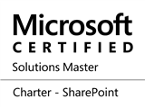




Paul Papanek Stork
Owner/Principal Architect
Don’t Pa..Panic Consulting
Author
Developer’s Guide to WSS 3.0
MOSS 2007 Best Practices
MCTS: WSS 3.0 Configuration Study Guide (70-631)
SharePoint 2010 Development for Office 365
Microsoft Community Contributor
    Technet Forums
    MSDN Forums
    Yammer Groups
Contact Information
Email:
pstork@dontpapanic.com
Blog:
http://dontPaPanic.com/blog
Twitter:
@PStork
Notes:
Principal SharePoint Architect for BlueChip Consulting Group
http://www.bluechip-llc.com
SharePoint MVP for 9 years
SharePoint Microsoft Certified Master
Author
Developer’s Guide to WSS 3.0
MOSS 2007 Best Practices
MCTS: WSS 3.0 Configuration Study Guide (70-631)
SharePoint 2010 Development for Office 365
Contact Information
Email: Paul.Stork@bluechip-llc.com
Blog: http://dontPaPanic.com/blog
Twitter: @PStork

Slide 3
Agenda
The Problem we are Solving
The Demo – What We’ll Be Building
What is Desired State Configuration (DSC)?
DSC – A Simple Example
Steps to build the SharePoint Farm in Azure
  Build the Infrastructure – PowerShell
  Configure the Virtual Machines – DSC
Reviewing the Scripts

Slide 4
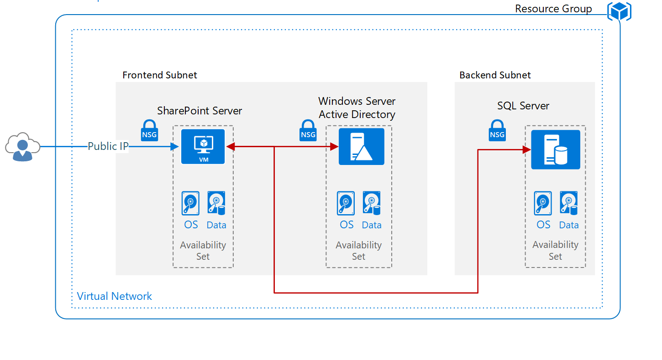
Kicking Off the Demo – The Farm
Don’t Pa..Panic Consulting

Slide 5
Kicking Off the Demo – The Scripts
3 PowerShell Scripts
  BuildVmAdDSC.ps1 – Builds a Server to be a Domain Controller
  BuildVmSqlDSC.ps1 – Builds a Basic SQL Server
  BuildVmSptDSC.ps1- Build a Basic SharePoint Server
5 PowerShell DSC Scripts
  BuildADserverDSC.ps1 – Installs the Domain
  BuildSQLserverDSC.ps1 – Configures the SQL environment
  BuildSPTserverDSC.ps1 – Setup base server
  InstallSPTserverDSC.ps1 – Create the basic Farm & Web Apps
  ConfigureSPTserverDSC.ps1 – Configure SharePoint Services
Download at https://www.dontpapanic.com/DSC/scripts.zip

Slide 6
The Problem we are Solving
Installing SharePoint Farms is time consuming and tedious
Manual configuration is prone to mistakes
Scripted configuration is hard to modify and troubleshoot
Configurations drift away from Best Practices over time
I want a process that is
  Quicker (relatively speaking)
  Repeatable
  Configurable
  Self-repairing
Also called DevOps or Infrastructure as Code

Slide 7
What is Desired State Configuration DSC?
Introduced with PowerShell 4.0 in 2013
  Included in Windows Server 2012 R2 & Windows 8.1
Enhanced in PowerShell 5.0 & 5.1
DSC deployments are:
  Declarative not Imperative
  Autonomous not Dependent
  Idempotent (repeatable)
Notes:
https://docs.microsoft.com/en-us/powershell/wmf/5.1/dsc-improvements

Slide 8
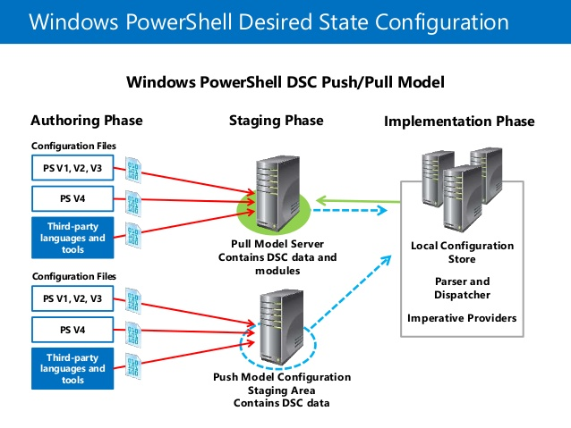
DSC Push and Pull Model
Configuration stored in Management Object Format (MOF)

Slide 9
Two Deployment Modes
Push – (Azure DSC Extension)
  Use Start-DscConfiguration to copy configuration to target node
  Node evaluates configuration immediately and again every 15 minutes (by default).
  Non-core DSC resources must be manually deployed to nodes.
Pull – (Azure Automation)
  Use push mode to enroll target node(s) and configure their pull server information.
  Target node(s) check the pull server every 30 minutes (default)
  MOF files are copied to pull server, and must be accompanies by a checksum file
  DSC resources are stored in ZIP archives on pull server
  Nodes will copy down any resources they are missing

Slide 10
DSC Key Components
Configurations - Declarative PowerShell scripts which define and configure instances of resources.
Resources - The "make it so" part of DSC. They contain the code that put and keep the target of a configuration in the specified state.
Local Configuration Manager (LCM) - The engine by which DSC facilitates the interaction between resources and configurations. It regularly polls the system to ensure that the state defined by a configuration is maintained.

Slide 11

A Simple DSC Configuration
Configuration WebsiteTest {
# Import the module that contains the resources we're using.
Import-DscResource -ModuleName PsDesiredStateConfiguration
# The Node statement specifies which targets this configuration will be applied to.
Node 'localhost’ {
LocalConfigurationManager {
ConfigurationMode = "ApplyOnly"
RebootNodeIfNeeded = $true
}
# The first resource block ensures that the Web-Server (IIS) feature is enabled.
WindowsFeature WebServer {
Ensure = "Present"
Name = "Web-Server"
}
# The second resource block ensures that the website content copied to the website root folder.
File WebsiteContent {
Ensure = 'Present'
SourcePath = 'c:\test\index.htm'
DestinationPath = 'c:\inetpub\wwwroot'
}
}
}
Don’t Pa..Panic Consulting

Slide 12
DSC Resource Design
Module
xNetworking
Resource
xIPAddress
Resource
xDNSServerAddress
“x” denotes “Experimental”
“c” denotes “Community”
For internal resources develop a private prefix
Module
xFirewall
Find more at: https://github.com/PowerShell/DscResources

Slide 13





Local Configuration Manager
Runs on all target nodes (part of WMF)
Has its own meta-configuration
  ActionAfterReboot
  AllowModuleOverwrite
  CertificateID
  ConfigurationMode
  ConfigurationModeFrequencyMins
Set-DscLocalConfigurationManager – Applies New Configuration Settings
  RebootNodeIfNeeded
  RefreshMode
  RefreshFrequencyMins
  StatusRetentionTimeinDays

Slide 14
DSC ConfigurationMode Settings
ApplyOnly
  DSC applies the configuration until successful completion
  DSC does not check for configuration drift
ApplyAndMonitor
  The default setting
  DSC reports configuration drift in the event logs
ApplyAndAutoCorrect
  DSC applies any new configurations until successful
  DSC reports any discrepancies in logs
  Re-applies the current configuration.

Slide 15
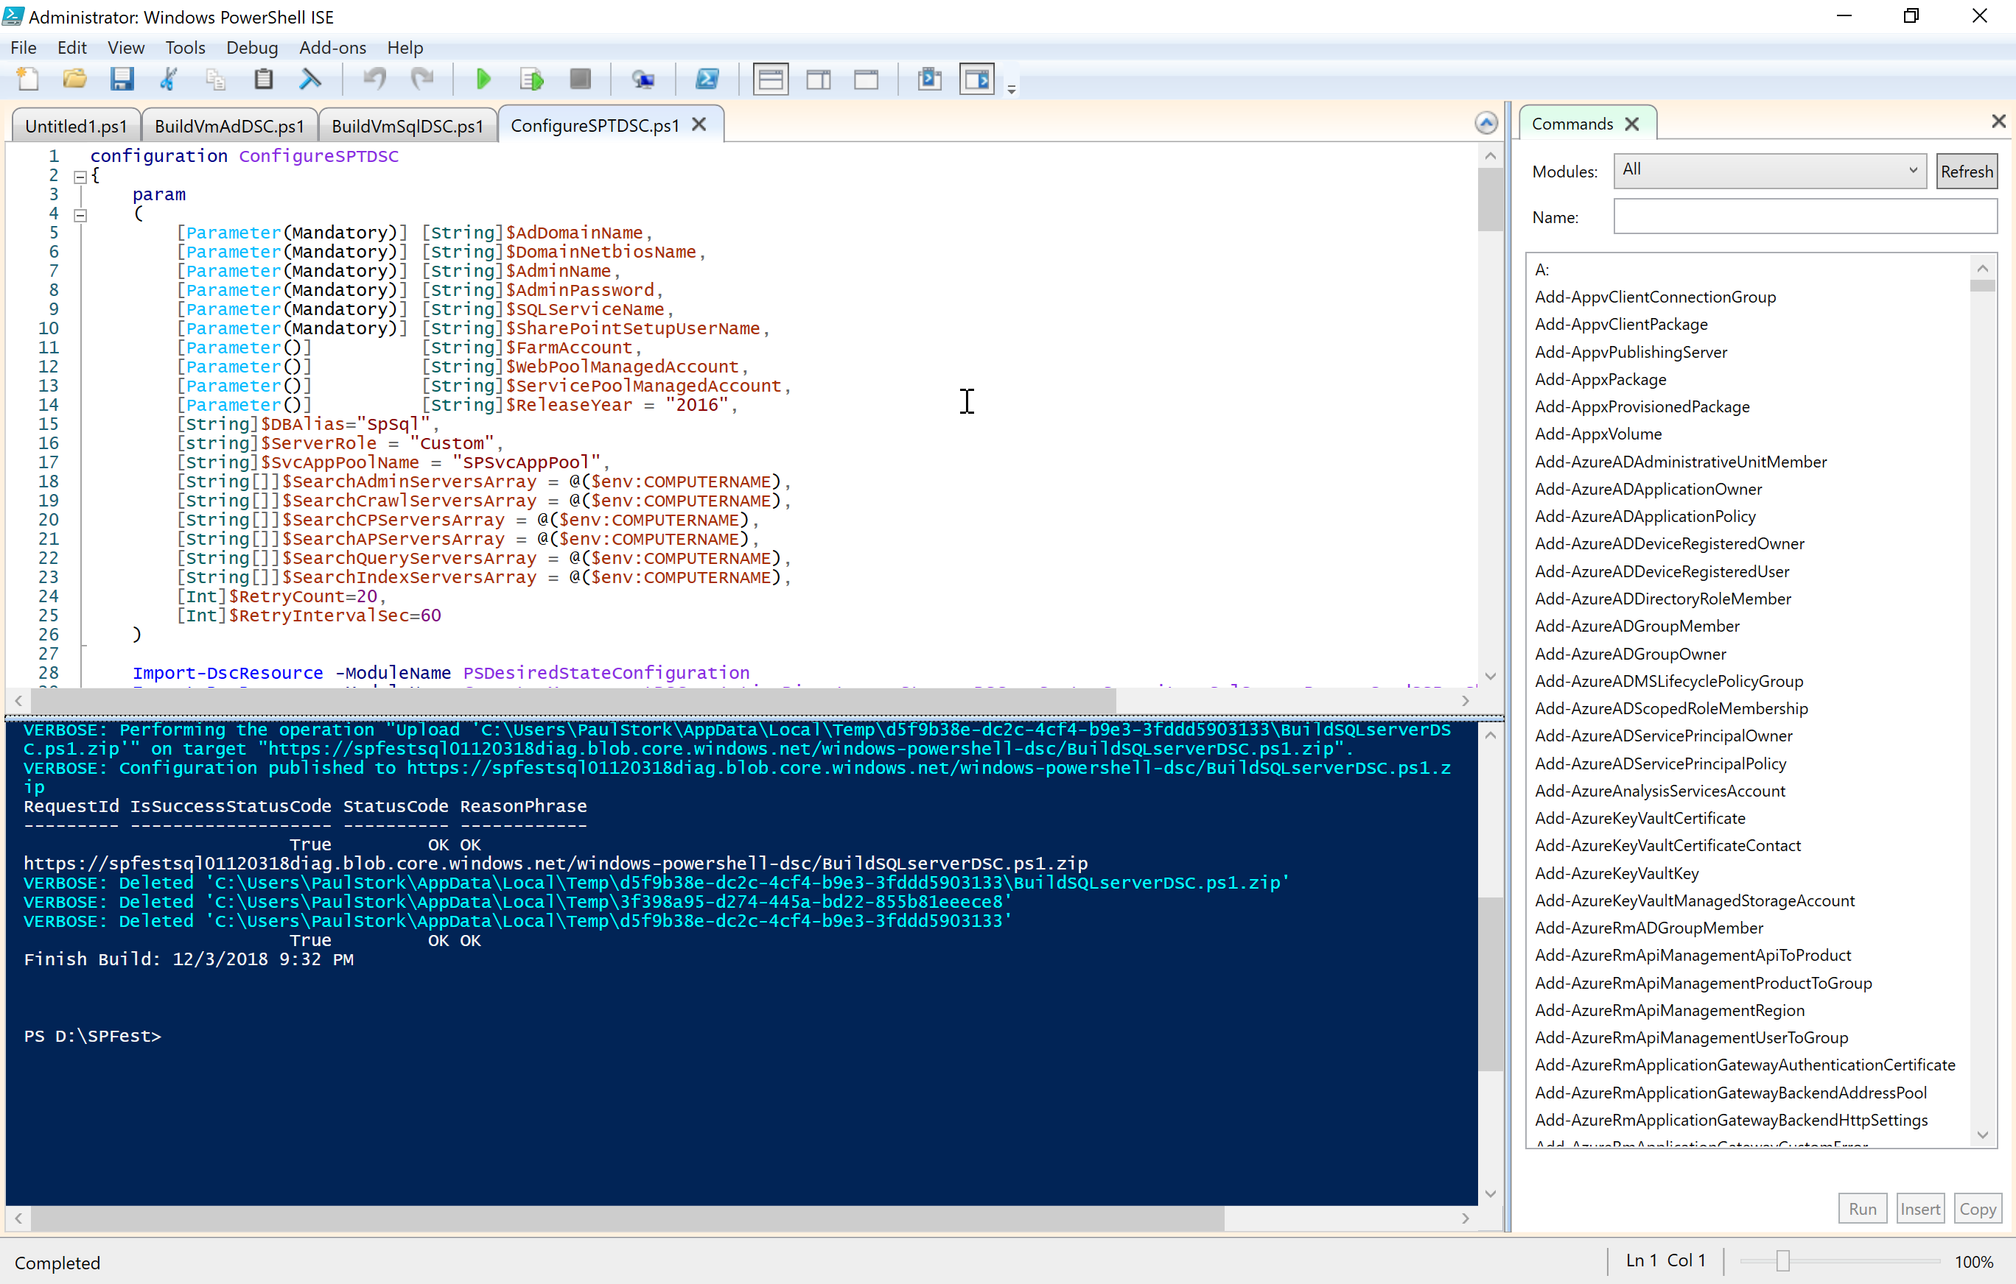
Reviewing the Scripts for SharePoint

Slide 16
Additional Resources
Windows PowerShell Desired State Configuration Overview
  https://docs.microsoft.com/en-us/powershell/dsc/overview
Introduction to the Azure Desired State Configuration extension handler
  https://docs.microsoft.com/en-us/azure/virtual-machines/extensions/dsc-overview
Azure Desired State Configuration extension version history
  https://docs.microsoft.com/en-us/powershell/dsc/azuredscexthistory
Pass credentials to the Azure DSCExtension handler
  https://docs.microsoft.com/en-us/azure/virtual-machines/extensions/dsc-credentials

Slide 17














Be Sure To Thank Our Sponsors!

Slide 18

Get Drink Tickets and Wristband During Closing Session Thursday

Slide 19

Win a Surface Book courtesy of Microsoft!
Play Vendor Bingo, Winner drawn during closing session on Friday

Slide 20


Questions?
Paul Papanek Stork - MCSM, MVP Owner\Principal Architect Email: pstork@dontpapanic.com Cell: 216.272.0573 Web: https://dontpapanic.com Twitter: @PStork

Slide 21
Windows PowerShell Desired State Configuration Overview
Windows PowerShell Desired State Configuration (DSC) is a new management system in Windows PowerShell that enables the deployment and management of configuration data for software services and the environment on which these services run. To use DSC, first create a configuration script as shown below. Note that Configuration is a new keyword, which is part of the Windows PowerShell extensions for DSC. Each Configuration can have one or more Node blocks. Each Node block can have one or more resource blocks. You can use the same resource more than once in the same Node block, if you wish. Configuration MyWebConfig { # Parameters are optional param ($MachineName, $WebsiteFilePath) # A Configuration block can have one or more Node blocks Node $MachineName { # Next, specify one or more resource blocks # WindowsFeature is one of the resources you can use in a Node block # This example ensures the Web Server (IIS) role is installed WindowsFeature IIS { Ensure = "Present" # To uninstall the role, set Ensure to "Absent" Name = "Web-Server" # Name property from Get-WindowsFeature } # You can use the File resource to manage files and folders # "WebDirectory" is the name you want to use to refer to this instance File WebDirectory { Ensure = "Present" # You can also set Ensure to "Absent“ Type = "Directory“ # Default is “File” Recurse = $true SourcePath = $WebsiteFilePath DestinationPath = "C:\inetpub\wwwroot" DependsOn = "[WindowsFeature]IIS" # Use for dependencies } } } To create a configuration, invoke the Configuration block the same way you would invoke a Windows PowerShell function, passing in any expected parameters you may have defined (two in the example above). For example, in this case: MyWebConfig -MachineName "TestMachine" –WebsiteFilePath "\\filesrv\WebFiles" ` -OutputPath "C:\Windows\system32\temp" # OutputPath is optional This creates a MOF file known as the configuration instance document at the path you specify. You can run it using the Start-DscConfiguration cmdlet (more on that cmdlet on the flipside of this sheet).
Archive Resource Example
The Archive resource gives you a mechanism to unpack archive (.zip) files at a specific path. Archive ArchiveExample { Ensure = "Present" # You can also set Ensure to "Absent" Path = "C:\Users\Public\Documents\Test.zip" Destination = "C:\Users\Public\Documents\ExtractionPath" }
Script Resource Example
The Script resource gives you a mechanism to run Windows PowerShell script blocks on target nodes. The TestScript block runs first. If it returns False, the SetScript block will run. The GetScript block will run when you invoke the Get-DscConfiguration cmdlet (more on that cmdlet on the flipside of this sheet). GetScript must return a hash table. Script ScriptExample { SetScript = { $sw = New-Object System.IO.StreamWriter("C:\TempFolder\TestFile.txt") $sw.WriteLine("Some sample string") $sw.Close() } TestScript = { Test-Path "C:\TempFolder\TestFile.txt" } GetScript = { <# This must return a hash table #> } }
Registry Resource Example
The Registry resource gives you a mechanism to manage registry keys and values. Registry RegistryExample { Ensure = "Present" # You can also set Ensure to "Absent" Key = "HKEY_LOCAL_MACHINE\SOFTWARE\ExampleKey" ValueName ="TestValue" ValueData ="TestData" }
Package Resource Example
The Package resource gives you a mechanism to install and manage packages, such as MSI and setup.exe packages, on a target node. Package PackageExample { Ensure = "Present" # You can also set Ensure to "Absent" Path = "$Env:SystemDrive\TestFolder\TestProject.msi" Name = "TestPackage" ProductId = "663A8209-89E0-4C48-898B-53D73CA2C14B" }
Environment Resource Example
The Environment resource gives you a mechanism to manage system environment variables. Environment EnvironmentExample { Ensure = "Present" # You can also set Ensure to "Absent" Name = "TestEnvironmentVariable" Value = "TestValue" }

Slide 22
Group Resource Example
The Group resource gives you a mechanism to manage local groups on the target node. Group GroupExample { # This will remove TestGroup, if present # To create a new group, set Ensure to "Present“ Ensure = "Absent" GroupName = "TestGroup" }
User Resource Example
The User resource gives you a mechanism to manage local user accounts on the target node. User UserExample { Ensure = "Present" # To delete a user account, set Ensure to "Absent" UserName = "SomeName" Password = $passwordCred # This needs to be a credential object DependsOn = “[Group]GroupExample" # Configures GroupExample first }
Service Resource Example
The Service resource gives you a mechanism to manage services on the target node. Service ServiceExample { Name = "TermService" StartupType = "Manual" }
Advanced Resource Properties
To see all the properties for a given resource, as well as the types of these properties, set the cursor on the resource keyword and press Ctrl + Spacebar. (The resource keywords are Registry, Script, Archive, File, WindowsFeature, Package, Environment, Group, User, Log, Service, and WindowsProcess.) All resources have a property called DependsOn that you can use to indicate when a given resource should be configured before another. See the User resource example for how to use it.
Configuration Data
This is an example of separating the node data from configuration logic. You can add more node hash tables to the AllNodes array. $ExampleConfigData = @{ AllNodes = @( # NodeName "*" applies globally to all nodes in this array @{ NodeName = "*"; RecurseValue = $true }, @{ NodeName = "Server101"; Role = "Web"; RolesToBePresent = "Web-Server"; SourceRoot = "\\Server106\source\presentation\"; Version = "1.0"; WebDirectory = "c:\inetpub\wwwroot\"; RecurseValue = $false; } ); } Configuration CloudService { # The $AllNodes and $Node (current node) variables are automatic variables Node $AllNodes.Where("Role -eq Web").NodeName { WindowsFeature IIS { Ensure = "Present"; Name = $Node.RolesToBePresent } } } CloudService –ConfigurationData $ExampleConfigData
Local Configuration Manager
Local Configuration Manager is the DSC engine. It runs on all nodes and is responsible for calling the resources in the configuration script. You can modify the Local Configuration Manager settings of a target node by including a "LocalConfigurationManager" block inside the Node block. LocalConfigurationManager { RebootNodeIfNeeded = $true # Automatically reboots if required by config ConfigurationMode = “ApplyAndAutoCorrect" # Corrects configuration drift } Set the cursor on the LocalConfigurationManager keyword and press Ctrl + Spacebar to see all the properties you can set and their types. Only one Local Configuration Manager settings block can exist per Node block. When you invoke a configuration that includes a Local Configuration Manager settings block, this will create a separate MOF file for the Local Configuration Manager settings. You can then enact these settings using the following cmdlet: Set-DscLocalConfigurationManager -Path "C:\MyFolder" # Generated MOF file location To set Local Configuration Manager settings using the MOF file for a specific node: Set-DscLocalConfigurationManager -ComputerName "MyNode" –Path "C:\MyFolder" To get the Local Configuration Manager settings: Get-DscLocalConfigurationManager -CimSession $session
Desired State Configuration Cmdlets
After you create a configuration as described in the Overview section on the flipside of this sheet, you need to enact (apply) it using the Start-DscConfiguration cmdlet. Use the following command to parse the configuration at the specified path, send each node its corresponding configuration, and enact those configurations. This cmdlet will return a Windows PowerShell Job object which can be useful for configurations that are long-running. Start-DscConfiguration -Path "C:\MyFolder" # Generated MOF file location To send a configuration to a specific node and enact that configuration: Start-DscConfiguration -ComputerName "TestMachine" -Path "C:\MyFolder" To make Start-DscConfiguration interactive, use the Wait parameter: Start-DscConfiguration –Verbose -Wait -Path "C:\MyFolder" To get the current configuration: Get-DscConfiguration -CimSession $session To restore the previous configuration: Restore-DscConfiguration -CimSession $session Suppose you want to compare the current and actual configurations. Test-DscConfiguration -CimSession $session

